Slide 1
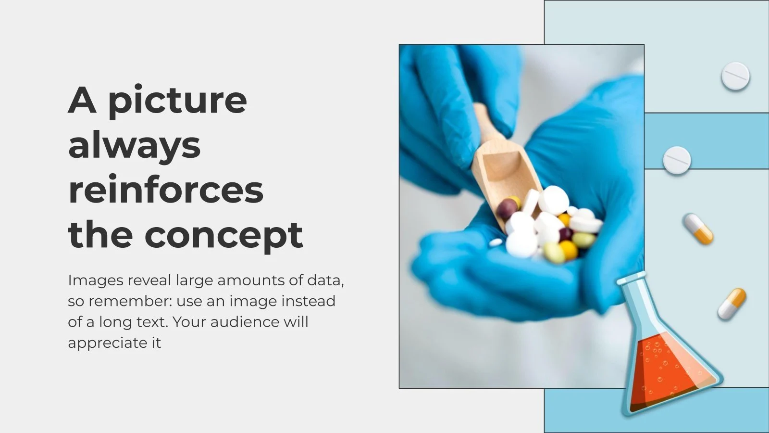
MEDICIADA
CARE FOR THOSE WHO NEED

Slide 2
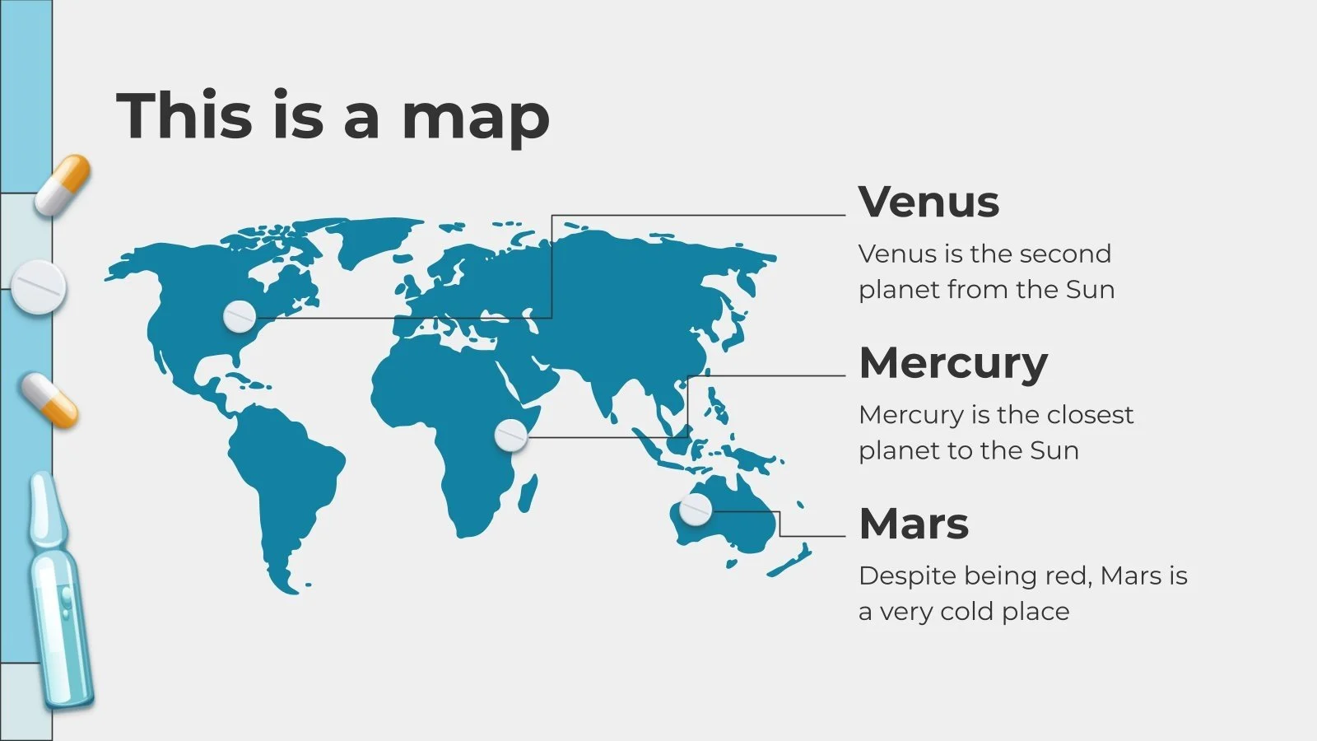
Problem statement:
Conceive and develop an innovative unified patient treatment platform (UPTP) capable of facilitating the exchange and accessibility of patient data across diverse health care providers ,clinics and individual patients.

Slide 3
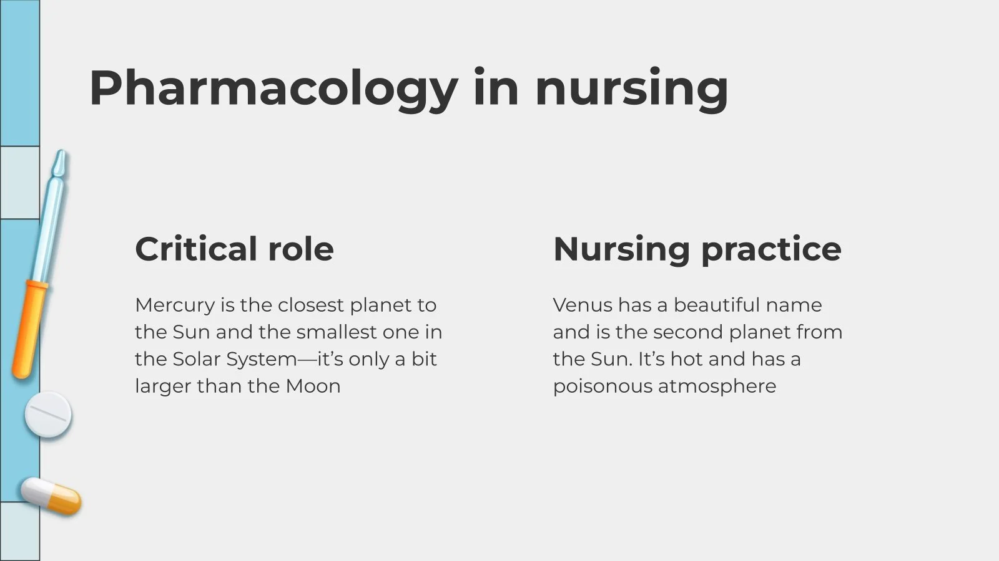
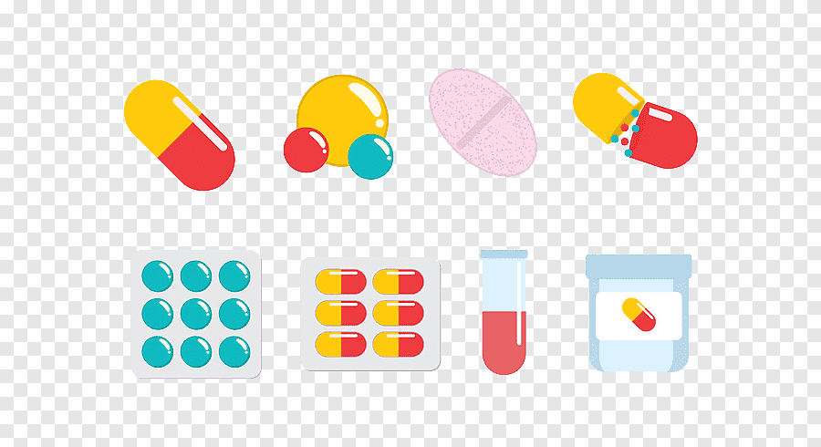
OBJECTIVE
To empowers patients with control over their healthcare data while aiding healthcare provides in providing timely well informed treatment.

Slide 4

Enhance patient engagement provide timely excess to medical records ,and support health care providers in delivering more accurate and expeditive care.
AIM

Slide 5

Key features
>>>>
Patient- centric access
Seamless integration
Real time updates
Diagnostic support
<<<<

Slide 6

Patient Centric Access- enables patient to securely excess and review their healthcare history which includes medical records ,prescriptions ,test results and treatment plans .additionally protects patient data and healthcare privacy regulations.
Seamless integration- Design UPTP with focus on seamless integration which focuses on patient management , software's in hospitals and clinics.
Ex- electronic health records(EHR), systems.
Healthcare databases
Health information exchange platforms.

Slide 7
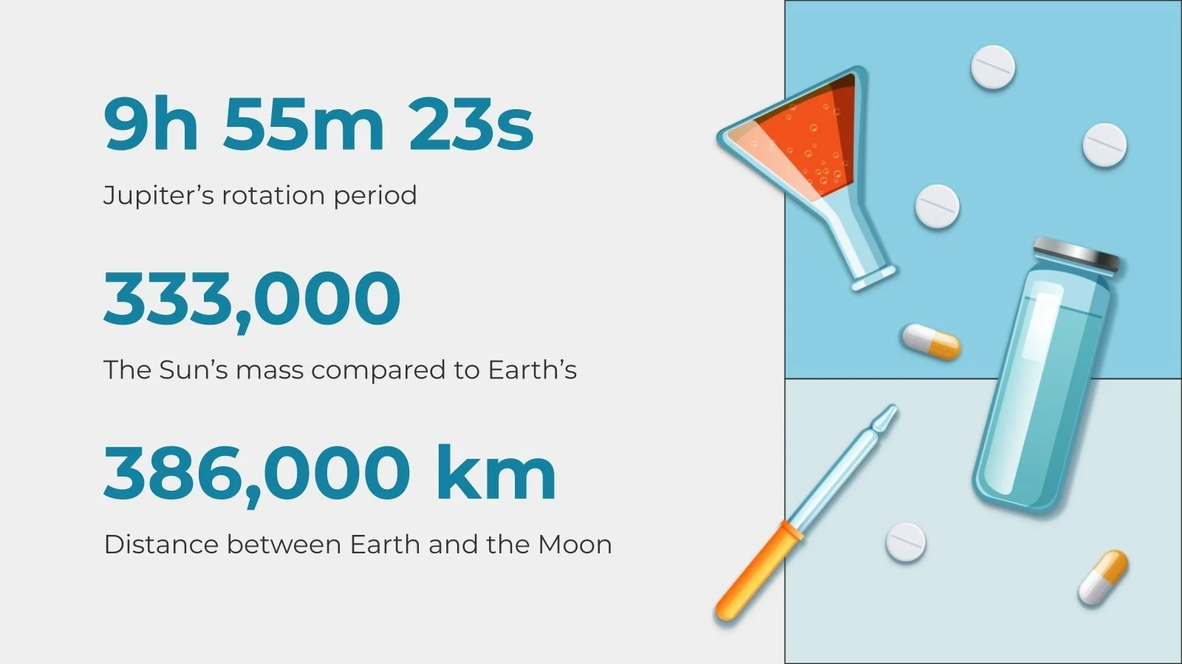
Real Time Updates-patient records ,ensured that healthcare provides have excess to more up to date information during diagnosis and treatment planning .
Diagnostic Support – leverage AI –driven capabilities diagnosis and treating patient more efficiently .
E.g. – incorporate decision support system

Slide 8
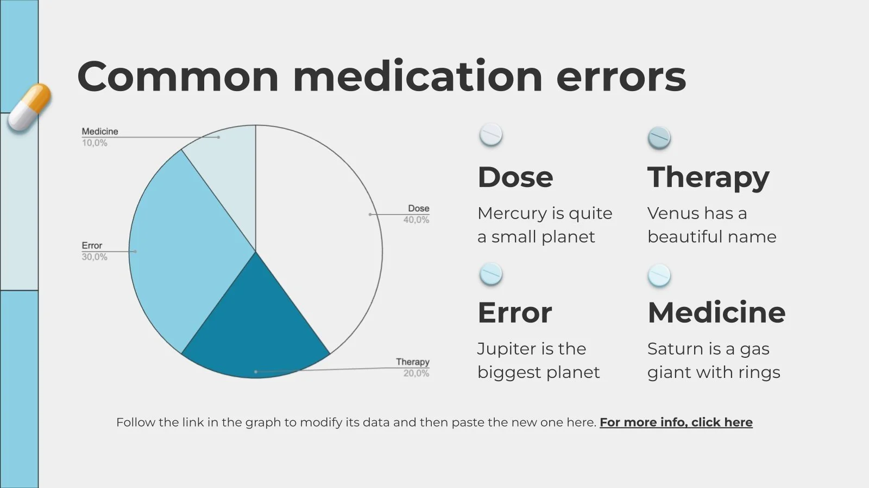
re
Requirements of UPTP
Develop a user friendly UPTP that places a premium on patient data privacy and security.
Create An Integration Mechanism that enables healthcare facilities to seamlessly connects the UPTP with existing patient management software such as features that empowers patient two excess view ,and share their healthcare records .
AI driven diagnostic and treatment assistance functionalities .
Ensure UPTP is adaptable for hospitals ,clinics and other healthcare settings .

Slide 9
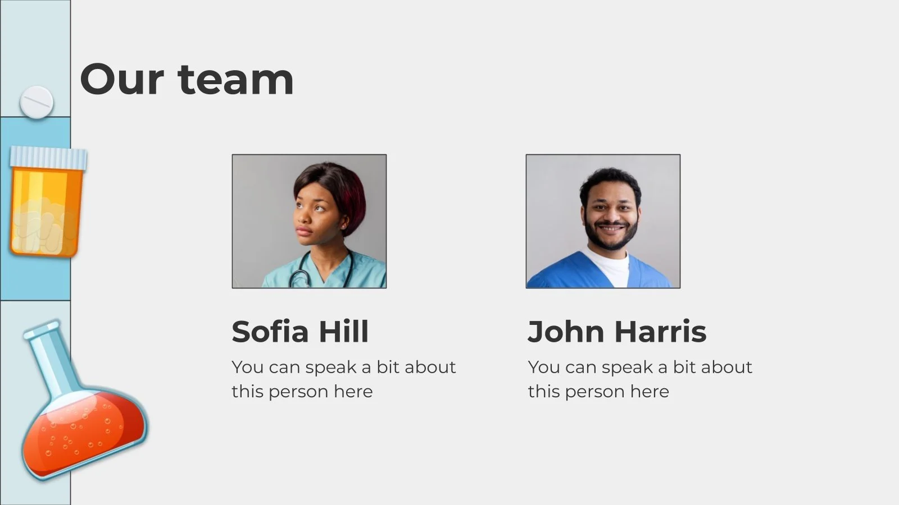
OPTIONAL FEATURES
Patient are encouraged to explore additional enhancement.
Development of mobile applications versions of UPTP , optimizing patient access via smartphones and tablets.
Integration of wearables and lot devices to facilitate real time patient data capture .
Implementation of secure communications channels for patient to interact with healthcare providers .

Slide 10


